Slide 1

STOCK MARKET VOLATILITY PREDICTION USING MACHINE LEARNING

Slide 2
Pathway
Step 1 : use existing models to study application of machine learning algorithms on large data.
Step 2: modify dataset from stock market data to VIX index data (i.e make a simplified model resembling the complex model used later)
Step 3 : apply modifications using numpy methods
Step 4 : compare predictions of simplistic models (sml models) to LSTM (used for medium sized data)

Slide 3

Model chosen
An Long Short-Term Memory (LSTM) type neural network model was chosen
It is widely used to study stocks and will be useful to study VIX index data as well
It generally works well with any time series input as it can remember long-term dependencies in sequence data.
In short it has all the features of a standard RNN (Recurrent Neural Network ) but also remembers long term dependencies.
There exists a gate navigation mechanism in LSTM that helps it “remember”.
Forget gate – for throwing away data . Cell gate – memory. Input and output gate are self explanatory

Slide 4
Data used
Stock price (close price) data was collected using Pingo API via Pandas DataReader for the time range January 2015 to May 2024.
It was then converted to a .csv format for use with python.
Normalized the closed price values to a relative score (from 0 to 1 ) for use with LSTM model. This was done using MinMaxScaler from the Scikit-learn library.
A 65-35 split was done to the data while retainingits sequence (essential for time series). The larger portion was used for training and smaller was used for testing.

Slide 5
Model architecture
“Sliding windows ” technique was used to get data into a supervised learning format. Previous 100 days input was used to predict the next day price.
The neural network had 3 LSTM layers stacked. Of these two were just 50 units each and the final layer had just 1 layer. The final layer was kept only 1 neuron dense because it represents the output of just 1 variable.
The aim was to compile the model for minimizing mean squared error loss.(RMSE)

Slide 6
The pipeline
1. Load and preprocess data
2. Split into train/test
3. Create time-stepped datasets
4. Reshape for LSTM input (!!!)
5. Build and train the model
6. Predict on train and test sets
7. Inverse transform predictions
8. Evaluate and plot results

Slide 7
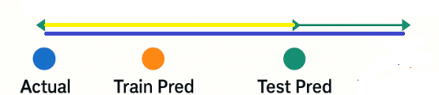
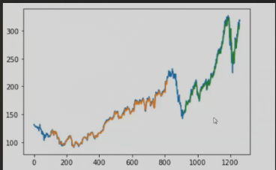
Results
The blue line shows actual stock price historically (whole data)
Orange line shows the predictions made which can be compared to our data.
Green line shows future predictions .
Training rmse was 225 and test rmse was 235 . So , the model did slightly worse than expected

